Slide 1
Service Integration
Ngo Huy Bien
Software Engineering Department
Faculty of Information Technology
VNUHCM - University of Science
Ho Chi Minh City, Vietnam
nhbien@fit.hcmus.edu.vn

Slide 2

References
Uwe Zdun et al. (2005). A Survey of Patterns for Service-Oriented Architectures.
Sanjiva Weerawarana et al. (2005). Web Services Platform Architecture. Prentice Hall PTR.
Matjaz B. Juric (2006). Business Process Execution Language for Web Services. Packt Publishing.
Gautam Shroff (2010). Enterprise Cloud Computing. Cambridge University Press.

Slide 3
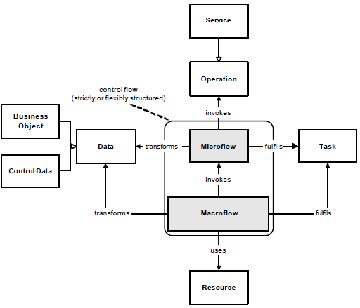
Process-Aware Information System [1]
A process-aware information system can be shaped by five perspectives:
data (or information)
resource (or organization)
control flow (or process)
task (or function)
and operation (or application).
This view can be mapped to the SOA approach: services are a specialization of the general operation perspective.

Slide 4
Process Flow
The control flow perspective is captured by a process engine.
In order to create the link between an activity of a process and a service, integration logic (process flow) is required.
We distinguish between two general types of process flow: macro-flow representing the higher-level business process, and micro-flow addressing the process flow within a macro-flow activity.
The distinction between micro- and macro-flow is a conceptual decision in order to be able to design process steps at the right level of granularity when designing at the long running business process level (macro-flow) or the short running, more technical level (micro-flow).

Slide 5
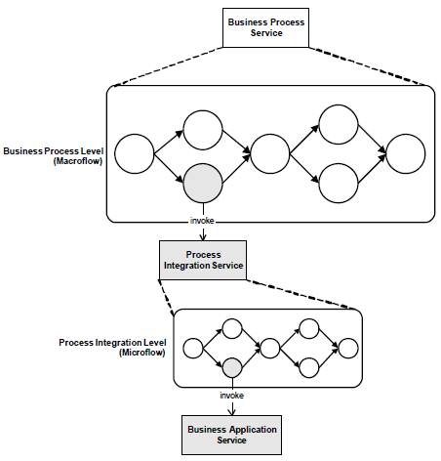
Process Service Levels
On the one hand a process flow orchestrates the service invocations, but on the other hand a business process may be exposed itself as a service.
Several levels of service invocation can be classified as follows:
A business process service represents a business process being exposed as a service
A process integration service depicts process integration logic at the micro-flow level
A business application service is a service that is offering functionality of a business application

Slide 6
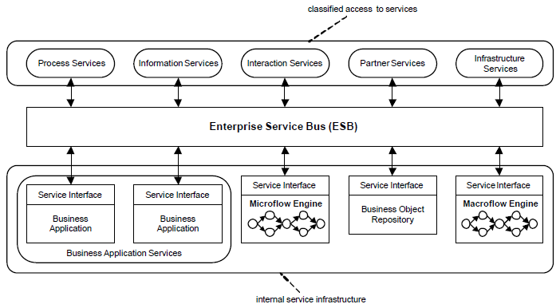
Enterprise Service Bus (ESB)
Enterprise Service Bus (ESB) is an architectural pattern in which various components connect to a service bus via their service interfaces.
ESB integrates concepts of SOA, EAI, and workflow management.

Slide 7
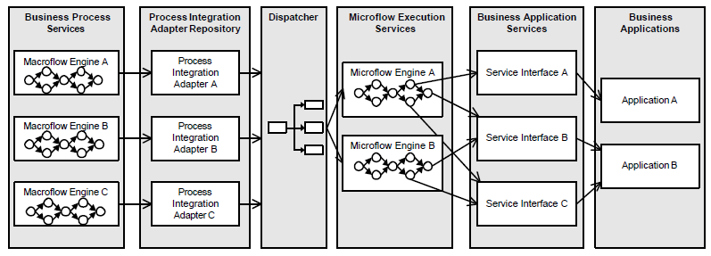
Process Integration Architecture
Process integration services are the connection between a macro-flow activity of a business process and a service interface in the backend.

Slide 8


Slide 9
Web Services Business Process Execution Language (BPEL) [2]
Composition of services into business processes requires the definition of collaboration activities and data-exchange messages between involved web services [3].
BPEL which is being standardized at OASIS is an extensible workflow-based language that aggregates services by choreographing service interactions.
It specifies an XML syntax and execution semantics for business processes.

Slide 10
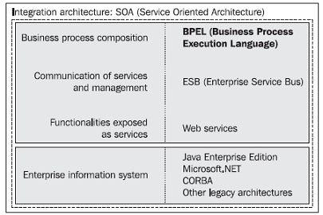
BPEL Goal [3]
BPEL promises to achieve the holy grail of enterprise information systems—to provide an environment where business processes can be developed in an easy and efficient manner and quickly adapted to the changing needs of enterprises without too much effort.

Slide 11
BPEL History
BPEL represents a convergence of two early workflow languages, WSFL (Web Services Flow Language) and XLANG.
WSFL was designed by IBM and is based on the concept of directed graphs.
XLANG was designed by Microsoft and is a block-structured language.
BPEL combines both approaches and provides a rich vocabulary for the description of business processes.
BPEL uses an XML-based vocabulary to specify and describe business processes.
To a certain extent, BPEL is similar to traditional programming languages. It offers constructs, such as loops, branches, variables, assignments, etc. that allow us to define business processes in an algorithmic way. BPEL is a specialized language focused on the definition of business processes.

Slide 12
BPEL Data [2]
The major building blocks of BPEL business processes are nested scopes that contain relationships to external partners, declarations for process data, handlers for various purposes and, most importantly, the activities to be executed.
The outermost scope is the process definition.
Data in BPEL is written to and read from lexically scoped, typed variables.
The values of these variables are either messages exchanged between the process and its partners, or intermediate data that is private to the process.
BPEL variables are typed using WSDL message types, XML Schema simple types, or XML schema elements.
XPath is the default language for manipulating and querying variables.

Slide 13
BPEL Activities
In WS-BPEL, the steps of a business process are called activities [3].
The activities in a BPEL process are either structured or basic.
Structured activities contain other activities and define the business logic between them.
Basic activities are, for example, the inbound or outbound Web service interactions or the specific activities for data manipulation.
Activities that deal with Web services are receive, reply, pick, invoke, and event handlers. These activities allow a process to exchange messages with the services that it composes.
The assign activity atomically copies data from one location to another, using a list of copy statements that copy one value each.

Slide 14
Structured Activities
Structured activities combine multiple activities to provide higher-level business logic.
These include sequence, switch, while, and flow activities.
The sequence activity is a simple aggregation of activities executed in the order in which they are specified.
The switch activity provides a multi-branch decision construct, and the while activity provides a loop construct.
You can execute activities in parallel by nesting them in a flow activity.
If you have to constrain the degree of parallelism, you can use conditional control links to specify a partial (acyclic) order on the set of activities nested in a flow.

Slide 15
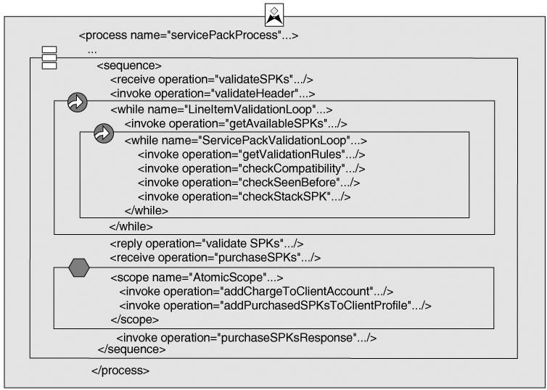
Service Pack Validation (SPK) Example

Slide 16
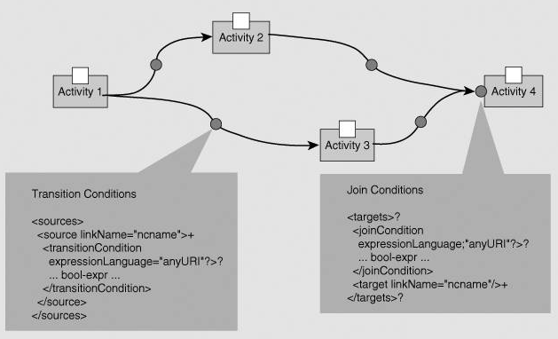
Links and Conditions
A transition condition is associated with each control link and evaluated at completion of the link's source activity.
A join condition is associated with an activity that is a target of links.

Slide 17
More Basic Activities
More basic activities are called empty, wait, terminate, throw, and compensate.
The empty activity is BPEL's rendering of a no-op. You can use it as a placeholder for other activities that you add later.
The wait activity provides a means to interrupt the execution for a specified time interval or until a specified time has been reached, and the terminate activity stops the execution of the process immediately.
The throw and compensate activities are used in conjunction with handlers for error detection and recovery.

Slide 18
BPEL Engines [2, 3]
A business process runtime system is WS-BPEL compliant if it can execute business processes that are expressed in WS-BPEL.
BPEL servers provide a run-time environment for executing BPEL business processes.
Oracle BPEL Process Manager, IBM WebSphere Business Integration Server Foundation, IBM BPWS4J, ActiveBPEL Engine and ActiveWebflow
Microsoft BizTalk http://www.microsoft.com/en-us/biztalk/default.aspx
http://wso2.com/products/business-process-server/
http://ode.apache.org/

Slide 19
BPEL Features [2]
The aggregation is recursive, such that the process exposes WSDL interfaces to those that interact with it, and the corresponding services may be used in other choreographies.
Designed to work in a highly dynamic environment in which services might change frequently, a BPEL process is intentionally decoupled from particular instances of the services it choreographs.

Slide 20
BPEL vs. WSDL [3]
WSDL provides the basic technical description and specifications for messages that are exchanged.
However, the description provided by WSDL does not go beyond simple interactions between the client (sender) and the web service (receiver).
These interactions may be stateless, synchronous, or asynchronous. These relations are inadequate to express, model, and describe complex compositions of multiple web services in business activities, which usually consist of several messages exchanged in a well-defined order.
In such complex compositions, synchronous and asynchronous messages can be combined, and interactions are usually long running, often involving state information that has to be preserved.
An important aspect is also the ability to describe how to handle faults and other exceptional situations.

Slide 21
BPEL vs. Programming Languages [3]
The composition of services into business processes could be realized using one of the well-known programming languages (Java, C#, …).
With composition, we merge functionalities (services) into larger services and processes. In other words, we do programming in the large, which differs from traditional programming in the small.
Programming in the large refers to representation of the high-level state transition logic of a system.
Using programming languages, such as Java, C#, etc., for composition often results in inflexible solutions, particularly because there is no clear separation between the process flow and the business logic, which should not be tightly coupled.

Slide 22
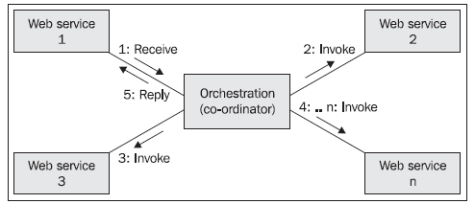
Orchestration [2]
In orchestration, a central process (which can be another web service) takes control over the involved web services and coordinates the execution of different operations on the web services involved in the operation.
The involved web services do not know (and do not need to know) that they are involved into a composition and that they are a part of a higher business process. Only the central coordinator of the orchestration knows this, so the orchestration is centralized with explicit definitions of operations and the order of invocation of web services.

Slide 23
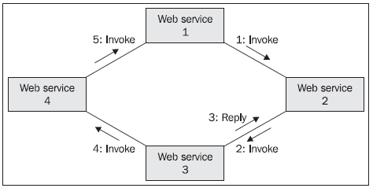
Choreography
Choreography does not rely on a central coordinator. Rather, each web service involved in the choreography knows exactly when to execute its operations and whom to interact with.
Choreography is a collaborative effort focused on exchange of messages in public business processes. All participants of the choreography need to be aware of the business process, operations to execute, messages to exchange, and the timing of message exchanges.

Slide 25
Four-layered SOA Architecture [3]
Business Process Layer is to define business processes expected by service clients.
Unit Service Layer: Activities of a business process are conceptual units of works, perceived by clients. It will eventually be performed by a software element, which we call a unit service.
Service Interface Layer contains the interfaces of services published by service provides, and it separates the unit services from the service components.
Service Component Layer is to specify service components which implement the service interfaces.

Slide 26
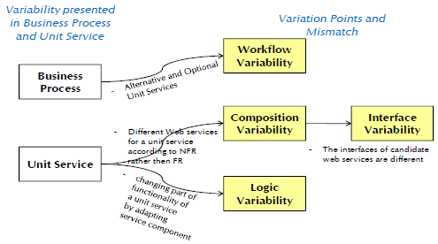
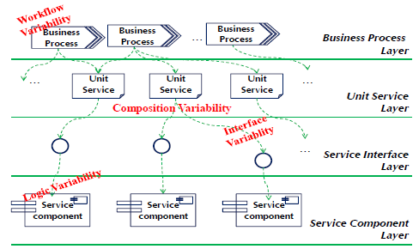
Four Type of Variability

Slide 27
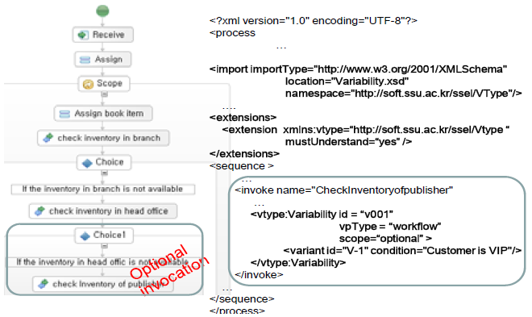
Workflow And Composition Variability

Slide 28
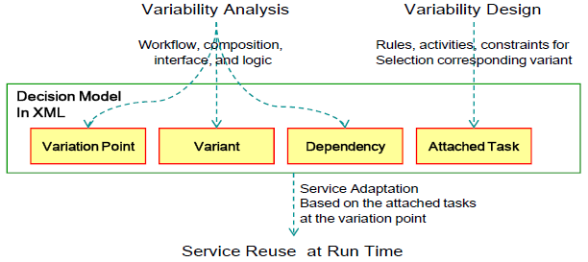
Usages of the Variability Models
With the models, variability of services can be easily recognized in business process and interface models.
The decision model is initiated in analysis and filled with attached tasks in design time.
Then, the rules, activities, and other constraints are referred in service adaptation when the services are called at run time.

Slide 30
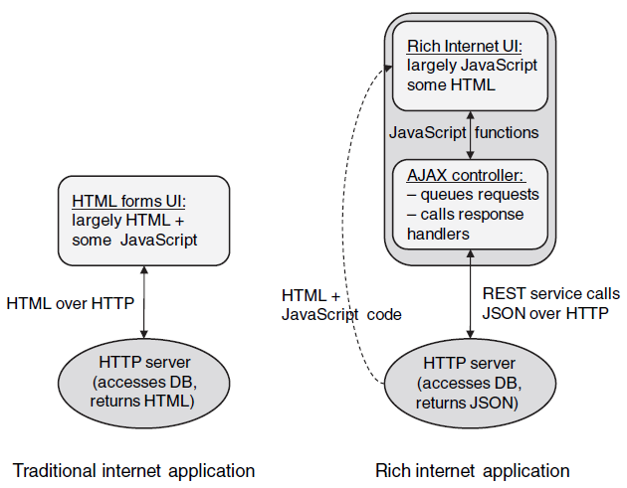
AJAX Applications [4]

Slide 31
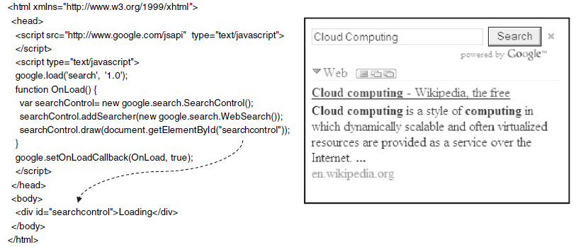
Mashups
Mashups take the level of integration one step further, by including the presentation layer for the remote service along with the service itself.
From a user perspective, mashups make it easy to consume web services. The only thing that is published is a JavaScript library which can be downloaded at runtime and executed by a client application.

Slide 32

Thank You & See You Again

